Slide 1
Audio Demos for the Paper Speech Enhancement by LSTM-Based Noise Suppression Followed by CNN-Based Speech Restoration
Maximilian Strake, Bruno Defraene, Kristoff Fluyt, Wouter Tirry, Tim Fingscheidt

Slide 2
1 Introduction
We offer the following audio demos for the paper “Components Loss for Neural Networks in Mask-Based Speech Enhancement”.
All the audio demos are using files from the test dataset in the presence of pedestrian (PED) noise at 10dB signal-to-noise ratio (SNR) level. The audios include speech from both female and male test speakers.
For 2CL and 3CL, we generate the audio demos for different parameters. Click on the loudspeaker symbols beside the curves and the ones under table to play the corresponding audio demos.
The equation number, table number, and figure number in these demos are referred to the corresponding equation, table, and figure in the paper, respectively.
The proposed components loss (CL) is easy to implement and code is provided at:
https://github.com/ifnspaml/Components-Loss
If you use the losses and/or the scripts in your research, please cite
@article{xu2019Comploss,
author = {Z. Xu, S. Elshamy, Z. Zhao and T. Fingscheidt},
title = {{Components Loss for Neural Networks in Mask-Based Speech Enhancement}},
journal = {arXiv preprint arXiv: 1908.05087},
year = {2019},
month = {Aug.} }
Notes:
During a communication, speech naturally come for us to pick up emotion content, since speech contains both emotion-related linguistic content, but also acoustic information.
2, SER can offer more intuitive human-to-machine interactions by allowing the machine to understand human emotions.
4, simulating or acting the emotions in a clear and natural way or getting unambiguous classes are a big challenge

Slide 3
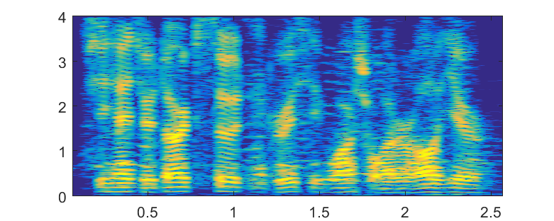
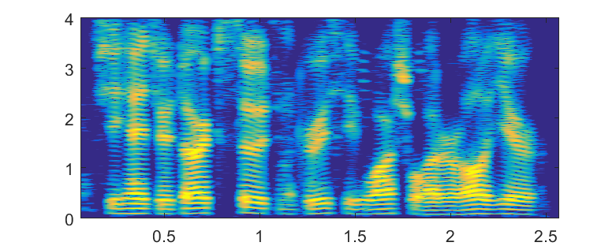

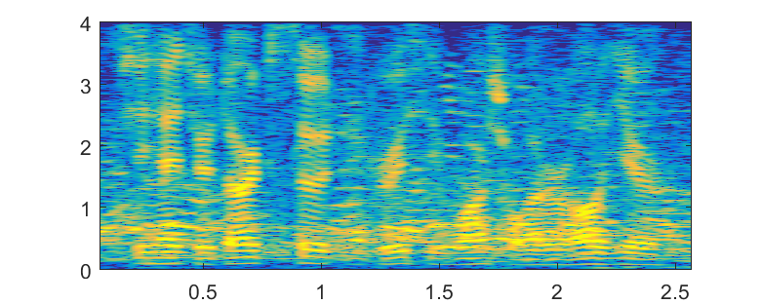
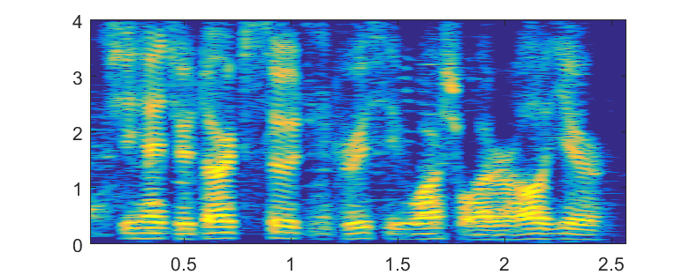

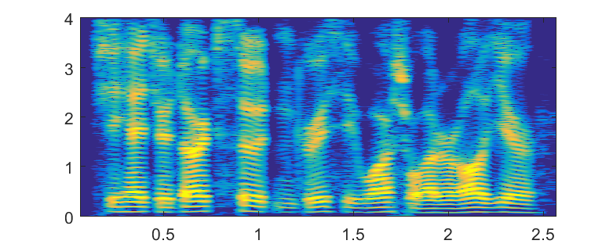
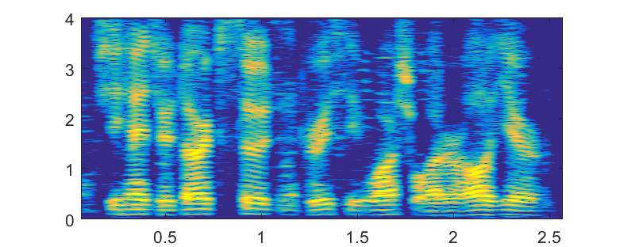

Audio Demos at SNR=5dB
Male Test Set Speaker in Unseen Pub Noise
Single Stage Baselines
Proposed Two-Stage Systems
LSTM-IRM
LSTM-cMSA+CED-cSA-du
Noisy Speech
LSTM-MSA
LSTM-cMSA+CED-cSA-tr
Clean Speech
LSTM-cMSA
LSTM-cMSA+CLED-cSA-du

Slide 4
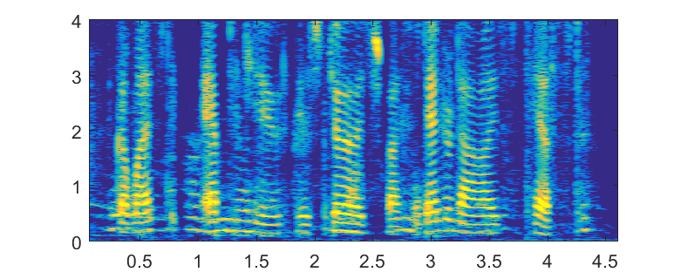
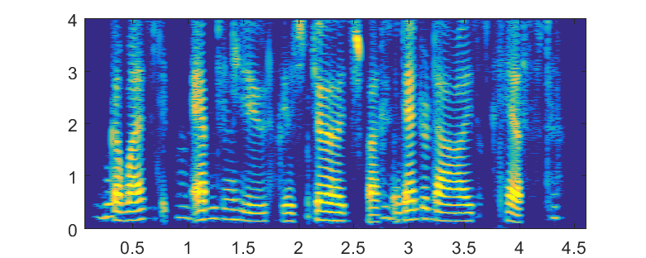
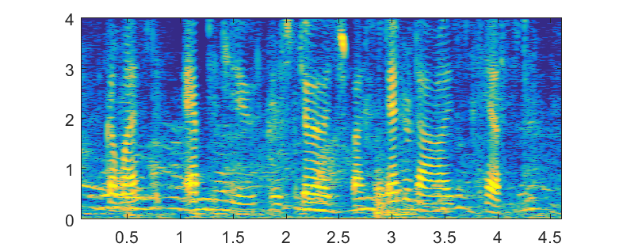
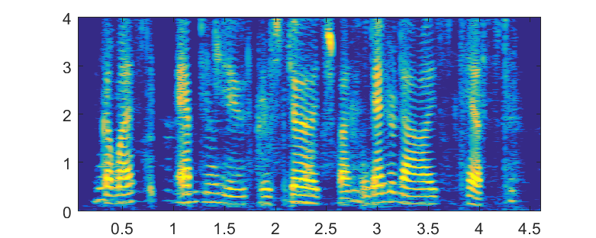
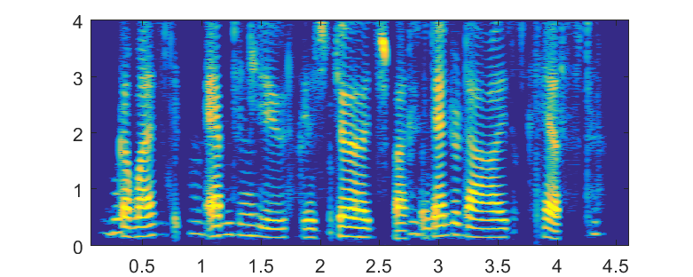
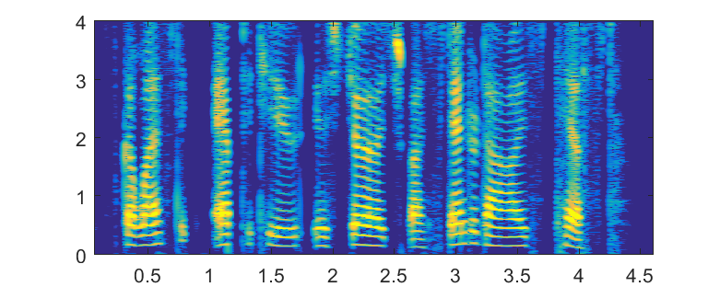


Audio Demos at SNR=5dB
Female Test Set Speaker in Unseen Office Noise
Single Stage Baselines
Proposed Two-Stage Systems
LSTM-IRM
LSTM-cMSA+CED-cSA-du
Noisy Speech
LSTM-MSA
LSTM-cMSA+CED-cSA-tr
Clean Speech
LSTM-cMSA
LSTM-cMSA+CLED-cSA-du

Slide 5
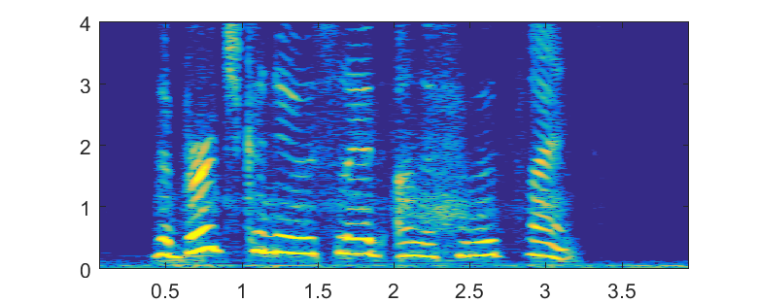
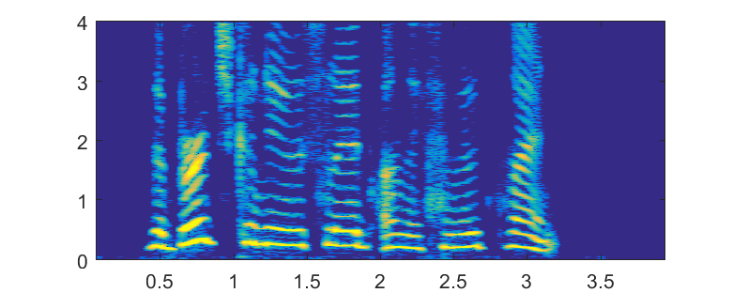
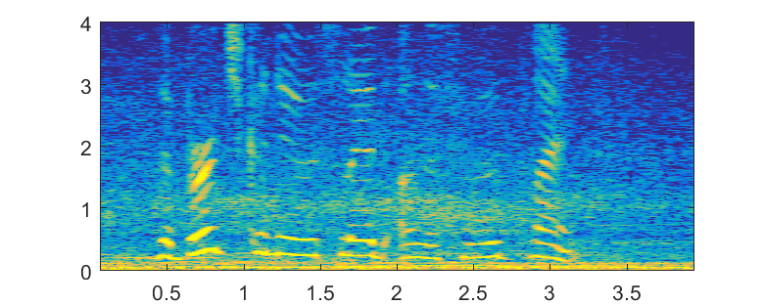
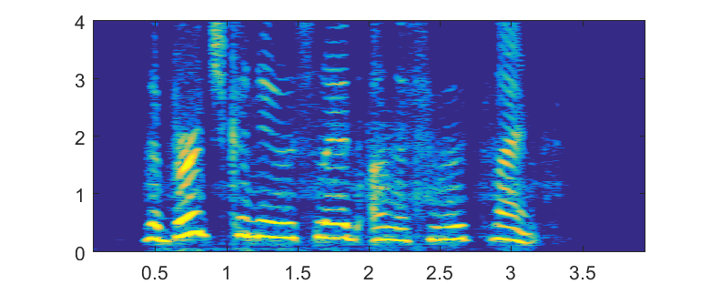
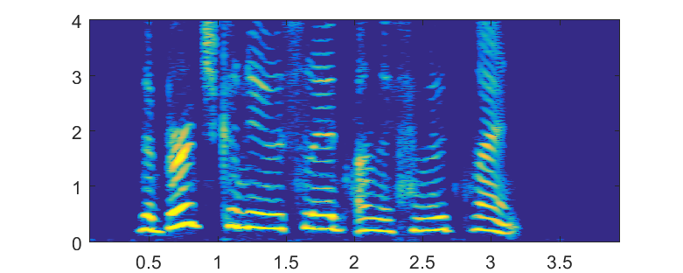
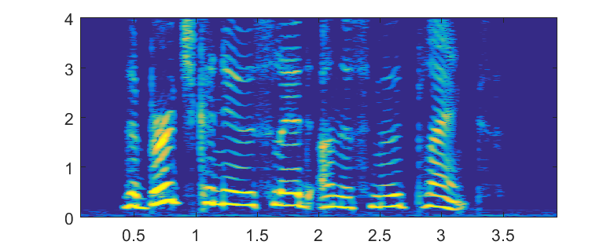
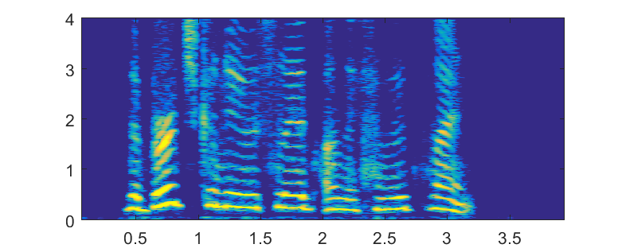
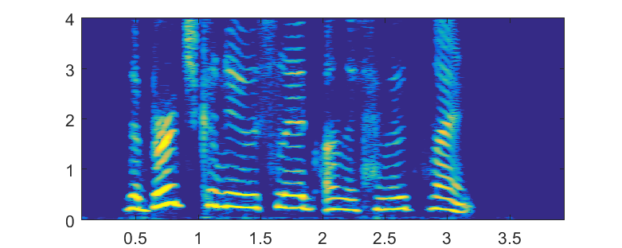
Audio Demos at SNR=5dB
Female Test Set Speaker in Unseen Traffic Noise
Single Stage Baselines
Proposed Two-Stage Systems
LSTM-IRM
LSTM-cMSA+CED-cSA-du
Noisy Speech
LSTM-MSA
LSTM-cMSA+CED-cSA-tr
Clean Speech
LSTM-cMSA
LSTM-cMSA+CLED-cSA-du

Slide 6
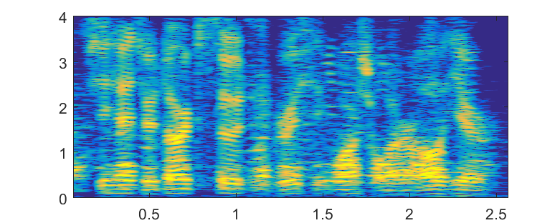
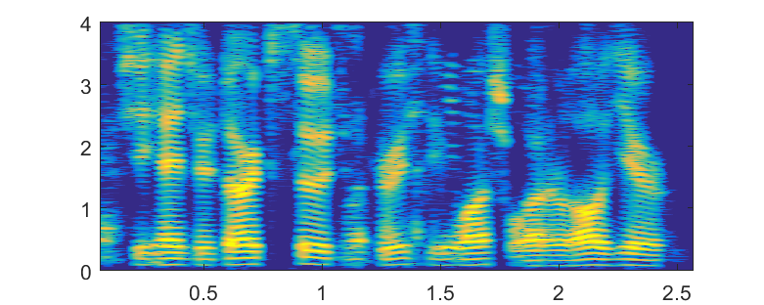
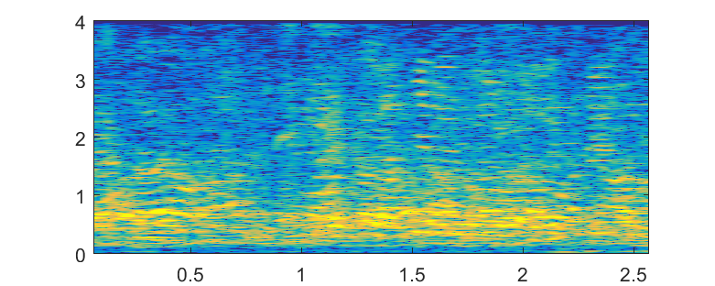
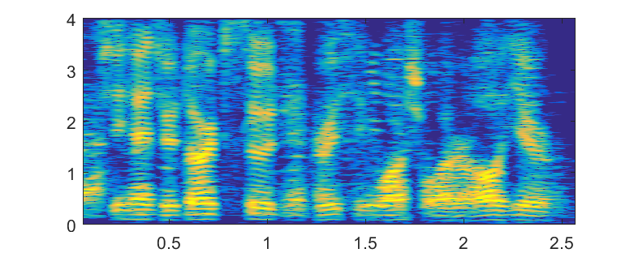
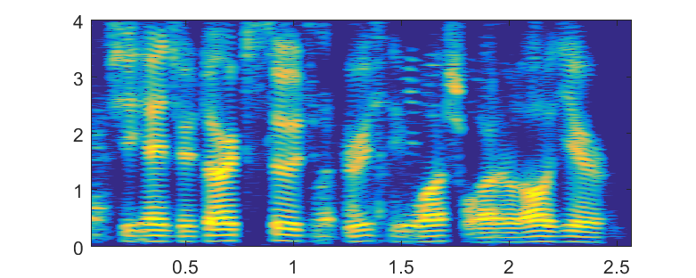

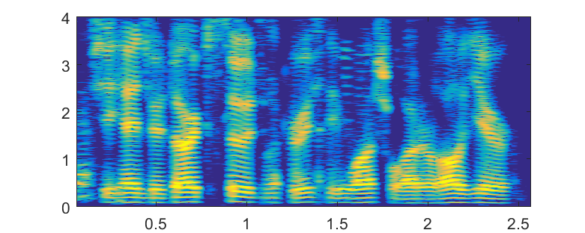
Audio Demos at SNR=0dB
Male Test Set Speaker in Unseen Pub Noise
Single Stage Baselines
Proposed Two-Stage Systems
LSTM-IRM
LSTM-cMSA+CED-cSA-du
Noisy Speech
LSTM-MSA
LSTM-cMSA+CED-cSA-tr
Clean Speech
LSTM-cMSA
LSTM-cMSA+CLED-cSA-du

